Slide 1
Verification of ALU
By Team5:
Omnia Mohamed
Ahmed Osama
Mahmoud Mohamed
Youssef Khaled

Slide 2
ALU Project Workflow
PHASE1
PHASE2
PHASE3
PHASE4
PHASE5
Understanding the design specs
Verification environment architecting
Implementation of the verification environment
Simulation Results
Making the verification plan

Slide 3
Verification Plan

Slide 5
ID | Design requirement description | Generation Requirement Description | Implementation
DR1 | clock frequency is 30 MHZ | generate clock of clock period 33.33ns | Implemented
DR2 | reset is active low and asynchronous | generate the reset signal | Implemented
DR3 | when alu_enable ==1 and alu_enable_a ==1, ALU reads alu_in_a,alu_in_b and alu_op_a | drive alu_enable and alu_enable_a and drive alu_op_a | Implemented
DR4 | when alu_enable ==1 and alu_enable_b ==1, ALU reads alu_in_a,alu_in_b and alu_op_b | drive alu_enable and alu_enable_b and drive alu_op_b | Implemented
DR5 | alu_op_a :2-bit input alu_op_a=0 : alu_out =AND, alu_in_b !=8'h0 , if alu_out==8'hFF, alu_irq==1 alu_op_a=1 : alu_out =NAND, alu_in_a !=8'hFF, alu_in_b !=8'h03 , if alu_out==8'h00, alu_irq==1 alu_op_a=2 : alu_out =OR, if alu_out==8'hF8, alu_irq==1 alu_op_a=3 : alu_out =XOR, if alu_out==8'h83, alu_irq==1 | randomize the signals (alu_op_a,alu_in_a,alu_in_b) with constrains on the illegal values. generate directly inputs which lead output to be the value which assert the alu_irq signal (if the randomization doesn't hit it). In NAND operation check that alu_irq signals will never be asserted(as out = 00 will obtained if and only if the two inputs are FF and alu_in_a != 8'hFF). | Implemented
DR6 | alu_op_b :2-bit input alu_op_b=0 : alu_out =XNOR, if alu_out==8'hF1, alu_irq==1 alu_op_b=1 : alu_out =AND , alu_in_b !=8'h03, if alu_out==8'hF4, alu_irq==1 alu_op_b=2 : alu_out =NOR ,alu_in_a !=8'hF5, if alu_out==8'hF5, alu_irq==1 alu_op_b=3 : alu_out =OR, if alu_out==8'hFF, alu_irq==1 | randomize the signals (alu_op_a,alu_in_a,alu_in_b) with constrains on the illegal values. generate directly inputs which lead output to be the value which assert the alu_irq signal (if the randomization doesn't hit it). | Implemented
DR7 | alu_irq_clr should be asserted for one clock cycle. And when it is high , alu_irq is low at the next clk cycle. | assert the signal irq_clr for one or more clock cycles. | Implemented
DR8 | alu_irq and alu_irq_clr get their value after one cycle from the inputs. | randomize alu_irq_clr | Implemented
DR9 | if alu_enable is zero then the outputs remain the same | randomize alu_enable | Implemented
DR10 | rst_n clears all outputs | generate rst_n | Implemented
DR11 | if alu_enable_a and alu_enable_b are both low while alu_enable is high then the outputs remain the same | randomize alu_enable_a and alu_enable_b with constraints | Implemented
DR12 | alu_irq has higher priority than alu_irq_clr so alu_irq will remain high even if its clear asserted at the same time |  | Implemented
DR15 | only one of alu_enable_a or alu_enable_b should be asserted high | randomize alu_enable_a and alu_enable_b with constraint alu_enable_a != alu_enable_b | Implemented

Slide 6
ID | Design requirement description | Checking Requirement Description | Implementation
DR1 | alu_clk frequency is 30 MHZ | check in all test cases that the design in operates successfully at this frequency | Implemented
DR2 | rst_n is active low and asynchronous | check that all output signals become zeros once reset is asserted low | Implemented
DR3 | when alu_enable ==1 and alu_enable_a ==1, ALU reads alu_in_a,alu_in_b and alu_op_a | check that the DUT reads the right operation with help of the monitor of input signals. | Implemented
DR4 | when alu_enable ==1 and alu_enable_b ==1, ALU reads alu_in_a,alu_in_b and alu_op_b | check that the DUT reads the right operation with help of the monitor of input signals. | Implemented
DR5 | alu_op_a :2-bit input alu_op_a=0 : alu_out =AND, alu_in_b !=8'h0 , if alu_out==8'hFF, alu_irq==1 alu_op_a=1 : alu_out =NAND, alu_in_a !=8'hFF, alu_in_b !=8'h03 , if alu_out==8'h00, alu_irq==1 alu_op_a=2 : alu_out =OR, if alu_out==8'hF8, alu_irq==1 alu_op_a=3 : alu_out =XOR, if alu_out==8'h83, alu_irq==1 | check that the result of all operations is correct check that alu_irq is asserted high if the output signal is one of the special outputs. | Implemented
DR6 | alu_op_b :2-bit input alu_op_b=0 : alu_out =XNOR, if alu_out==8'hF1, alu_irq==1 alu_op_b=1 : alu_out =AND , alu_in_b !=8'h03, if alu_out==8'hF4, alu_irq==1 alu_op_b=2 : alu_out =NOR ,alu_in_a !=8'hF5, if alu_out==8'hF5, alu_irq==1 alu_op_b=3 : alu_out =OR, if alu_out==8'hFF, alu_irq==1 | check that the result of all operations is correct check that alu_irq is asserted high if the output signal is one of the special outputs. | Implemented
DR7 | alu_irq_clr should be asserted for one clock cycle. And when it is high ,alu_irq is low at the next clk cycle. | check when alu_irq_clr is asserted high the signal alu_irq is deasserted after one clock cycle. | Implemented
DR8 | alu_irq and alu_out get their value after one cycle from the inputs. | check alu_out and alu_irq values at next edge | Implemented
DR9 | if alu_enable is zero then the outputs remain the same | check that alu_out remains the same if alu_enable is asserted low | Implemented
DR10 | rst_n clears all outputs | check that all outputs go to zero when rst_n is asserted low | Implemented
DR11 | if alu_enable_a and alu_enable_b are both low while alu_enable is high then the outputs remain the same | check that alu_out remains the same if alu_enable_a ,alu_enable_b are asserted low | Implemented
DR12 | alu_irq has higher priority than alu_irq_clr so alu_irq will remain high even if its clear asserted at the same time | check that alu_irq remains high when alu_irq_clr is asserted high and alu_out is one of special outputs | Implemented
DR13 | only one of alu_enable_a or alu_enable_b should be asserted high.

Slide 7
ID | Design requirement description | Coverage Requirement Description | Implementation
DR1 | clock frequency is 30 MHZ
DR2 | reset is active low and asynchronous | cover the reset test case. | Implemented
DR3 | when alu_enable ==1 and alu_enable_a ==1, ALU reads alu_in_a,alu_in_b and alu_op_a | cover alu_enable and alu_enable_a | Implemented
DR4 | when alu_enable ==1 and alu_enable_b ==1, ALU reads alu_in_a,alu_in_b and alu_op_b | cover alu_enable and alu_enable_b | Implemented
DR5 | alu_op_a :2-bit input alu_op_a=0 : alu_out =AND, alu_in_b !=8'h0 , if alu_out==8'hFF, alu_irq==1 alu_op_a=1 : alu_out =NAND, alu_in_a !=8'hFF, alu_in_b !=8'h03 , if alu_out==8'h00, alu_irq==1 alu_op_a=2 : alu_out =OR, if alu_out==8'hF8, alu_irq==1 alu_op_a=3 : alu_out =XOR, if alu_out==8'h83, alu_irq==1 | cover all the operations once at least and get alu_irq once at least in each operation except NAND operation because it will not be asserted. | Implemented
DR6 | alu_op_b :2-bit input alu_op_b=0 : alu_out =XNOR, if alu_out==8'hF1, alu_irq==1 alu_op_b=1 : alu_out =AND , alu_in_b !=8'h03, if alu_out==8'hF4, alu_irq==1 alu_op_b=2 : alu_out =NOR ,alu_in_a !=8'hF5, if alu_out==8'hF5, alu_irq==1 alu_op_b=3 : alu_out =OR, if alu_out==8'hFF, alu_irq==1 | cover all the operations once at least and get alu_irq once at least in each operation. | Implemented
DR7 | alu_irq_clr should be asserted for one clock cycle. And when it is high ,alu_irq is low at the next clk cycle. | cover that at least once the signal alu_irq_clr is asserted when the alu_irq is high and become low at the next edge of the clock. | Implemented
DR8 | alu_irq and alu_irq_clr get their value after one cycle from the inputs.
DR9 | if alu_enable is zero then the outputs remain the same
DR10 | rst_n clears all outputs
DR11 | if alu_enable_a and alu_enable_b are both low while alu_enable is high then the outputs remain the same
DR12 | alu_irq has higher priority than alu_irq_clr so alu_irq will remain high even if its clear asserted at the same time
DR13 | if alu_enable_a and alu_enable_b are both low while alu_enable is high then the outputs remain the same
DR15 | only one of alu_enable_a or alu_enable_b should be asserted

Slide 8
Architecture

Slide 9
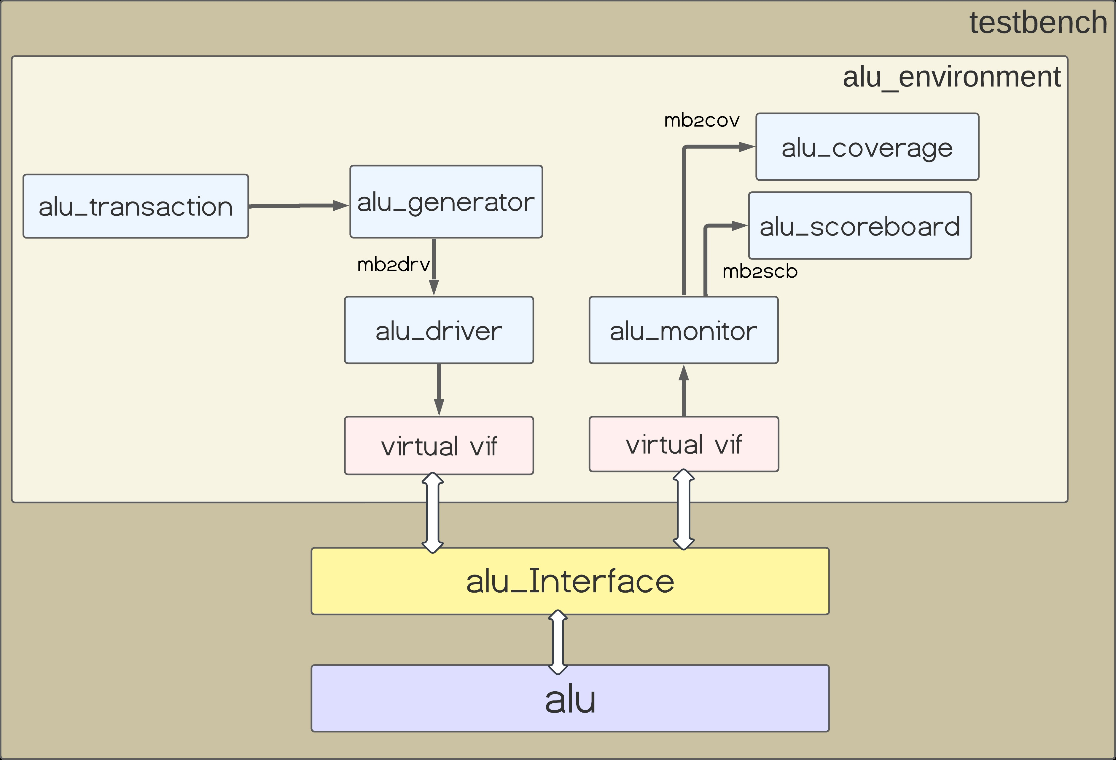

Slide 10
Design flowchart

Slide 11
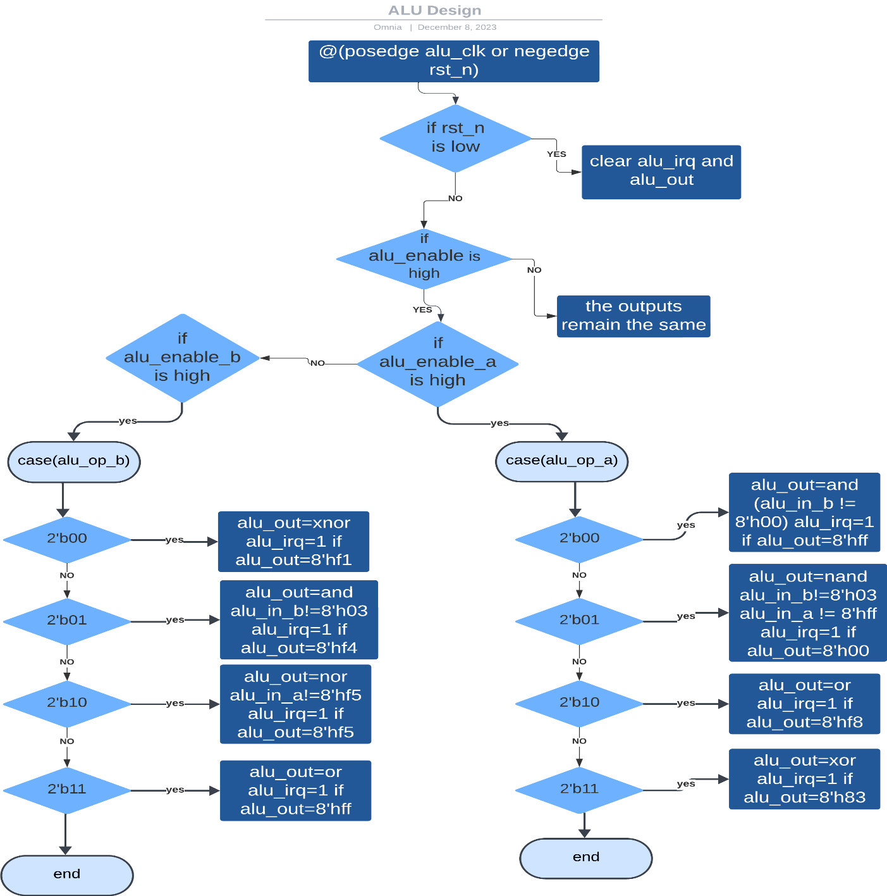

Slide 12
Verification Environment classes

Slide 13
Simulation Results

Slide 14
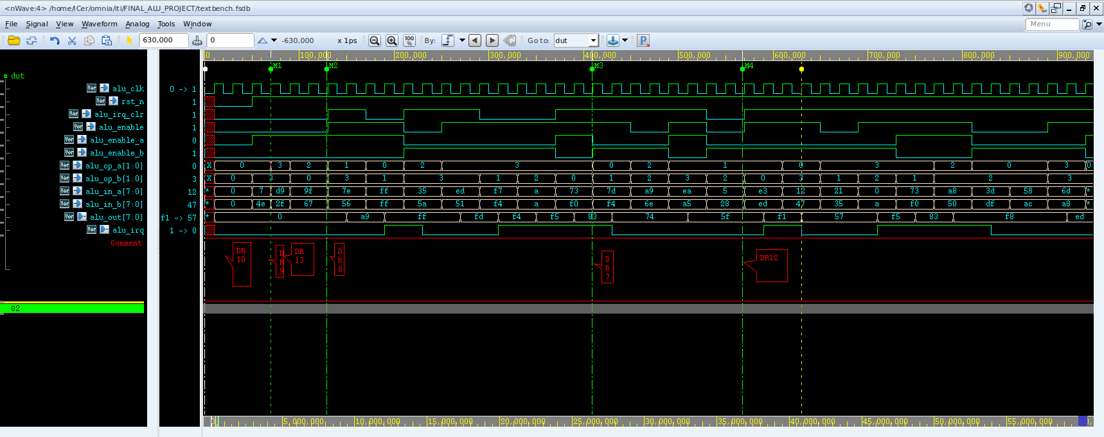

Slide 15
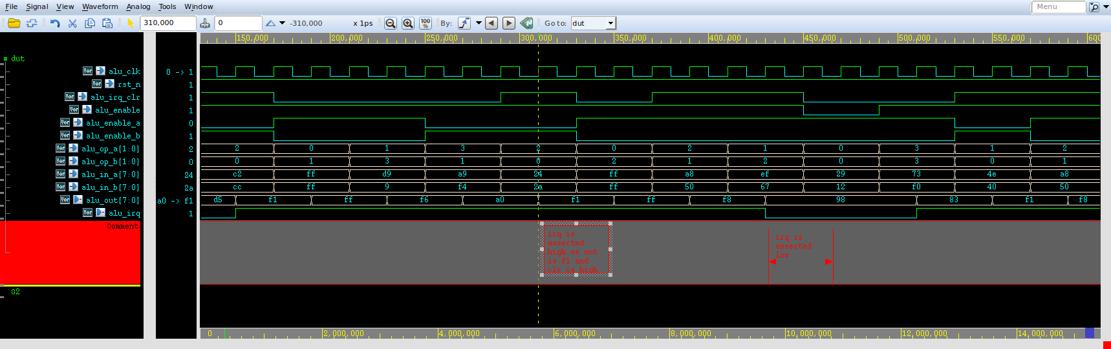

Slide 16
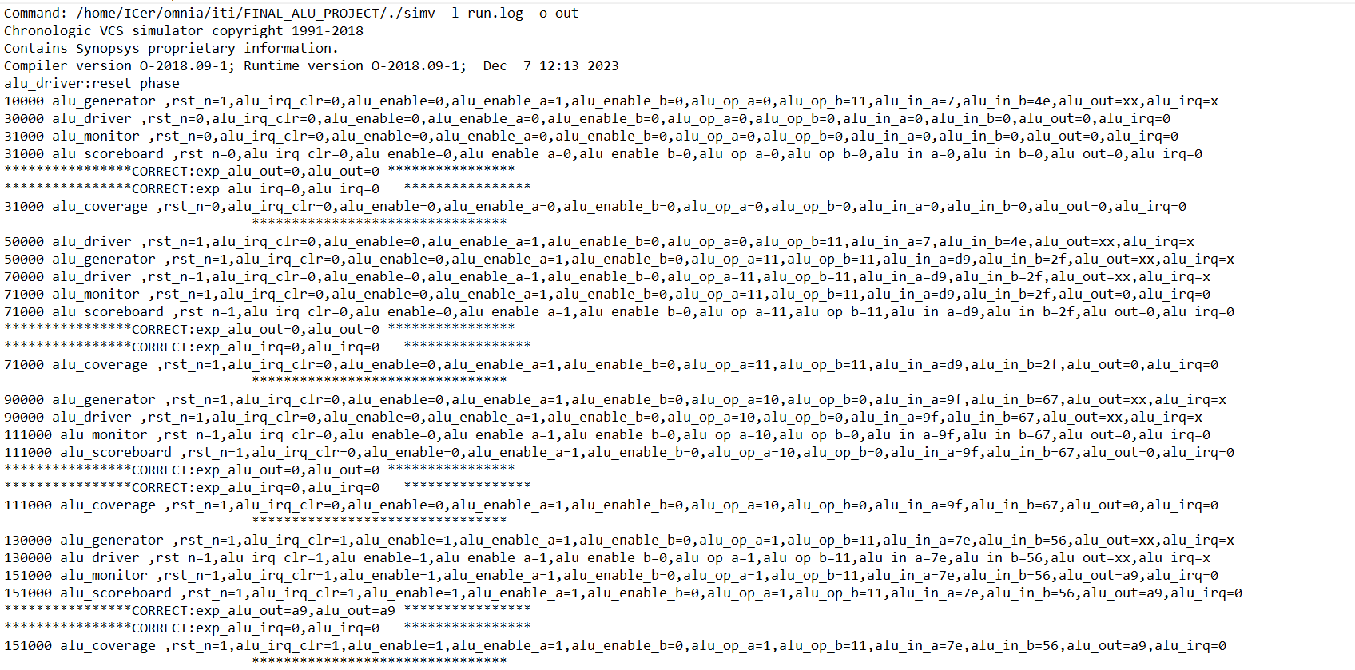

Slide 17
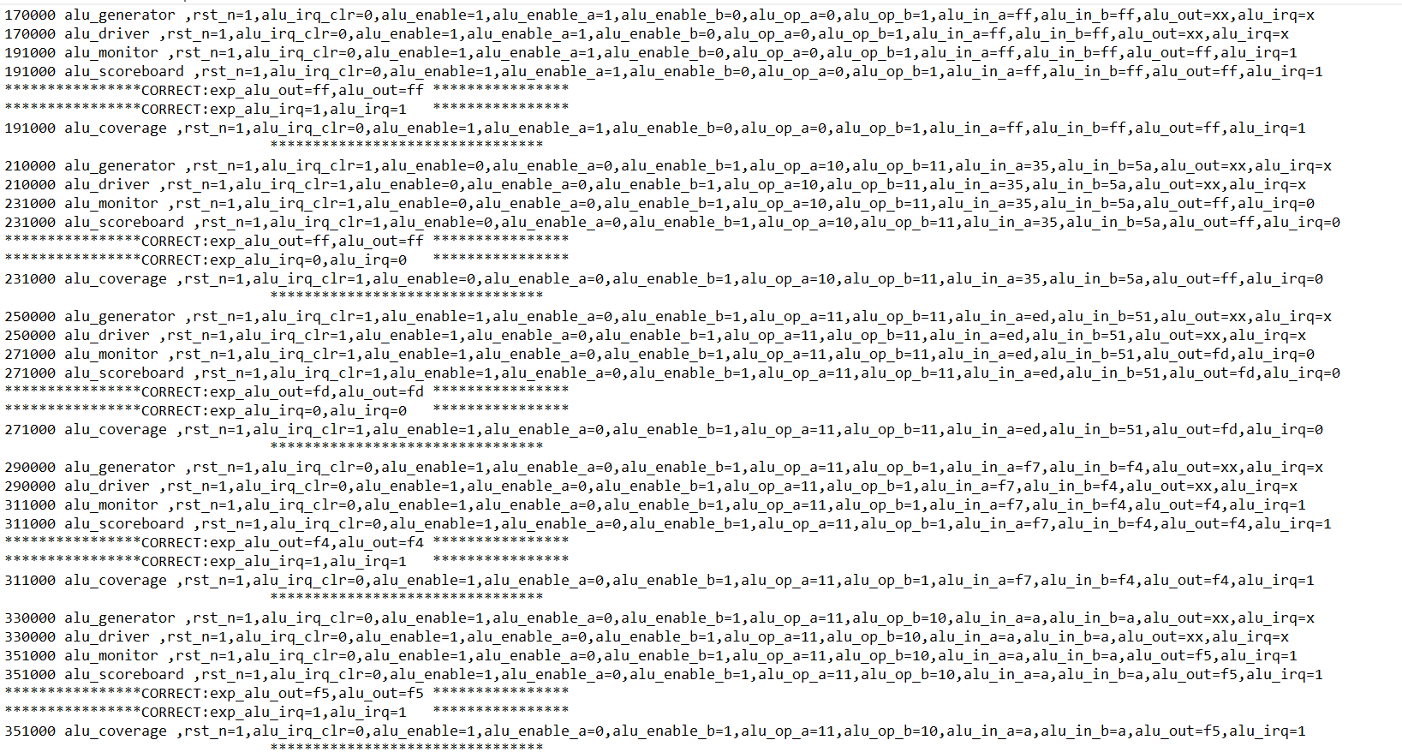

Slide 18
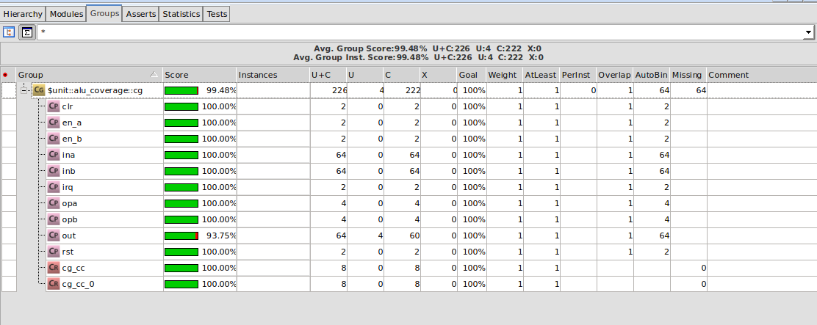

Slide 19
